Slide 1

Heart Disease Prediction
Group No. 6
Achanta Sai Krishna – CB.EN.U4ELC20004
Kuralanbu S – CB.EN.U4ELC20033
Vimal Dharshan N – CB.EN.U4ELC20081

Slide 2
CA1 Summary
We have researched about Knn classifier and Normalization inferred the following:
The Minkowski Distance is a metric in a normed vector space that uses both Manhattan and Euclidean distance in a generalized form for calculation.
Splitting the dataset into training and testing, where 70% for training and 30% for testing.
Cross Validation(cv): Re-sampling procedure used to evaluate a model.
For various values of K, the accuracy rates change, and the best case was found by plotting all the values.
The confusion matrix is used to determine the performance of the classification models for a given set of test data.
Normalization is a scaling technique where all the data in the dataset is scaled between a range that is 0 and 1.

Slide 3
CA2 Summary
We have researched PCA and Clustering and inferred the following:
Principal component analysis (PCA) is a statistical technique used in machine learning to reduce the dimensionality of data.
Clustering is a type of unsupervised learning in machine learning that involves grouping data into clusters based on similarity.
The optimal K value in K-means clustering is 5.
Covariance Matrix is a matrix used to represent the covariance values between pairs of elements given in a random vector.
Within-Cluster-Sum-of-Squares (WCSS). WCSS is the sum of squares of the distances of each data point in all clusters to their respective centroids.

Slide 4
References
Dataset:
https://www.kaggle.com/datasets/aasheesh200/framingham-heart-study-dataset
Reference:
https://www.geeksforgeeks.org/major-kernel-functions-in-support-vector-machine-svm/?ref=lbp
https://stackabuse.com/creating-a-neural-network-from-scratch-in-python-adding-hidden-layers/

Slide 5
Problem Formulation
Objective: To identify Heart Disease of a patient based on the given features
Dataset details:
No. of rows: 4239
No. of columns: 17
No. of Class: 02
Method of data collection is unknown
Assumptions:
From the link mentioned for dataset, “framingham.csv” was considered for solving
In features, “Male” is changed to “Sex”
In features, “TenYearCHD” is changed to “target”.
In features, “Education” is changed to “Chest Pain Type”.

Slide 6
Problem Formulation
Assumptions:
Missing data were filled with the mean of the rest of the corresponding data.
Link to full code mentioned in slides:
https://colab.research.google.com/drive/16uyj05TaI6HL9fSIjhew-szl_GvVU4IU#scrollTo=YSi4ALrJBSIZ
https://colab.research.google.com/drive/1vLlkQgshmdCh0aahd_3EqQ0lLSmMeIZQ?ts=639d6386

Slide 7
Feature Description
sex – The person’s sex (0 = female; 1 = male)
age – The person’s age in years
Chest Pain Type – 1: Typical Angina, 2: Atypical Angina, 3:Non-Angina Pain, 4:Asymptomatic
currentSmoker – The person is currently smoking (0 = false; 1 = true)
cigsPerDay – Amount of cigarettes smoked per day by a person
BPMeds – The person is taking medicine for blood pressure (0 = false; 1 = true)
prevalentStroke – The person has a common stroke (0 = false; 1 = true)
prevalentHyp – The person has common hypertension (0 = false; 1 = true)
diabetes – The person has diabetes (0 = false; 1 = true)

Slide 8
Feature Description
totChol – Total cholesterol of a person (in mg/dl)
sysBP – Systolic blood pressure of a person (in mm Hg)
diaBP – Diastolic blood pressure of a person (in mm Hg)
BP – Total blood pressure of a person (sysBP/diaBP)
BMI – Body Mass Index of a person (kg/m ² )
heartRate – Total heart rate achieved by a person (bpm)
glucose – Fasting blood sugar level of a person (mg/dl)
target – Heart Disease of a person (0 = false; 1 = true)

Slide 9
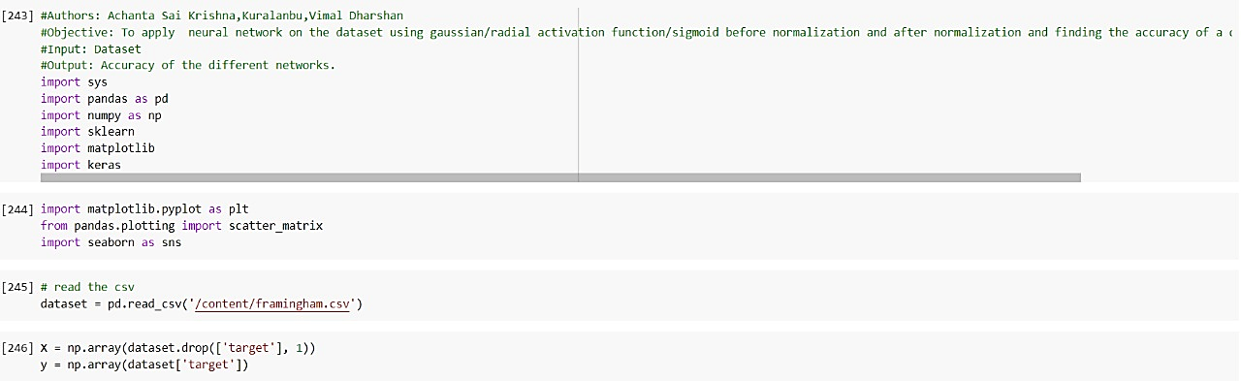
Neural Network
1. Importing the Libraries and the Datasets as array’s:

Slide 10
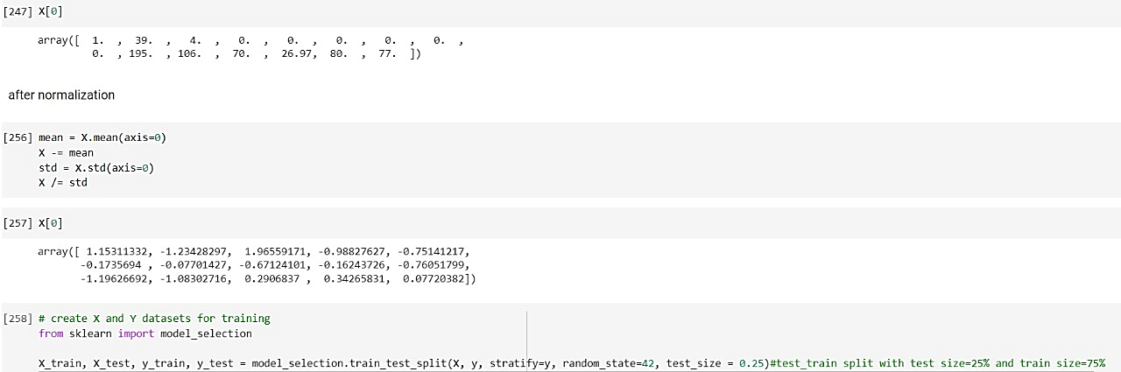
2. Normalization of array’s and creating the datasets for training and
testing:

Slide 11
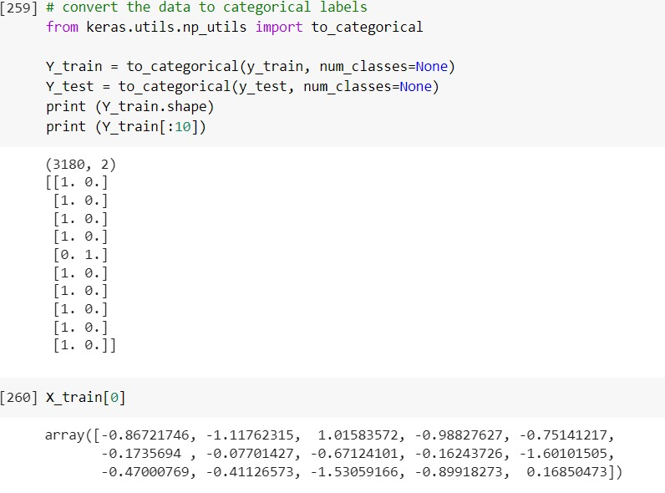
3. Convert the datasets to categorical labels:

Slide 12
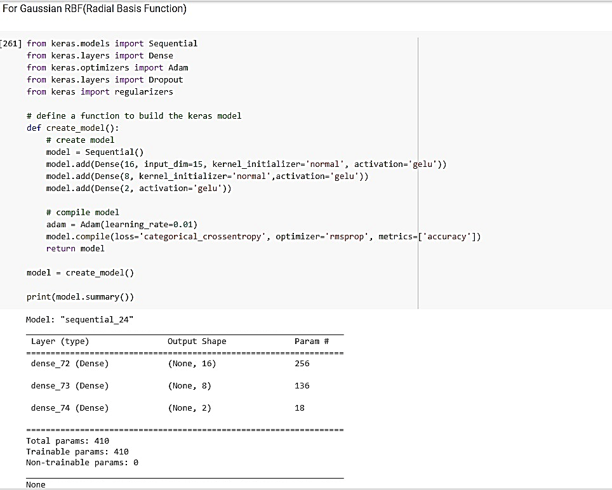
4. Gaussian Radial Basis Function (RBF) kernel:

Slide 13
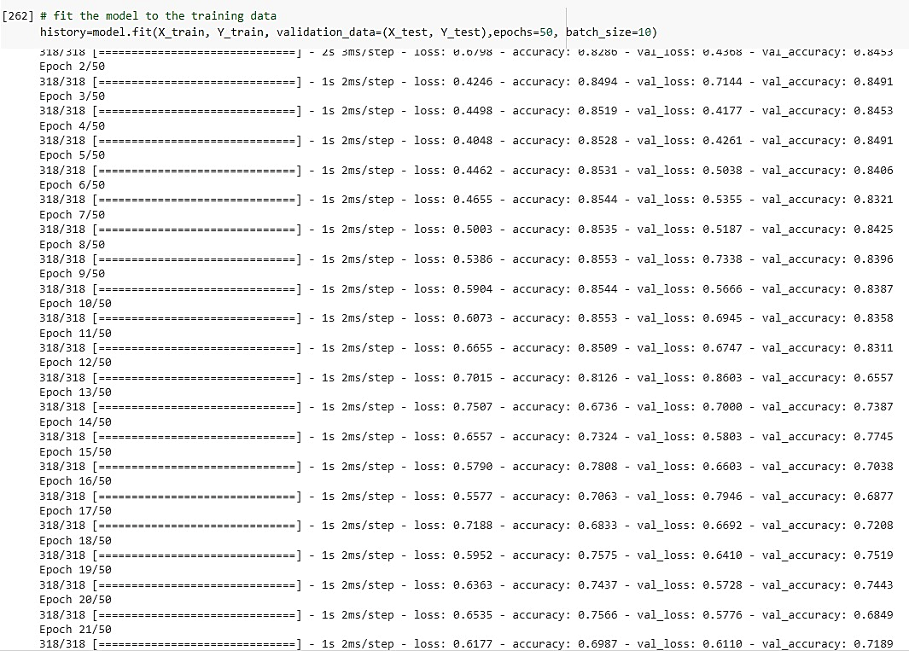
5. Fitting the model to train the RBF categorical datasets:

Slide 14
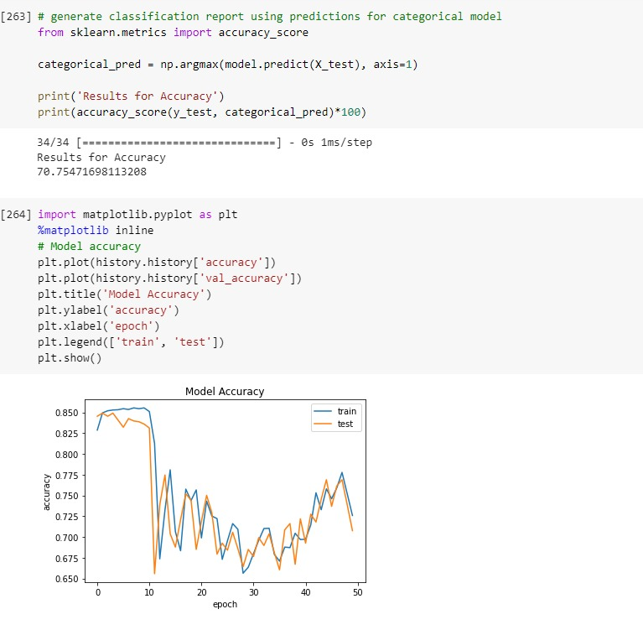
6. Generate classification report using predictions for categorical model for RBF:

Slide 15
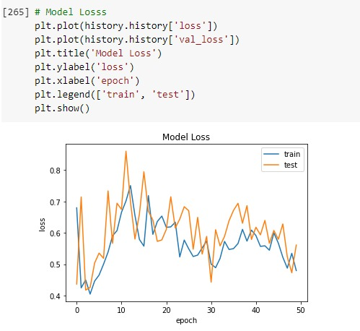
7. Model Losses for RBF categorical datasets:

Slide 16
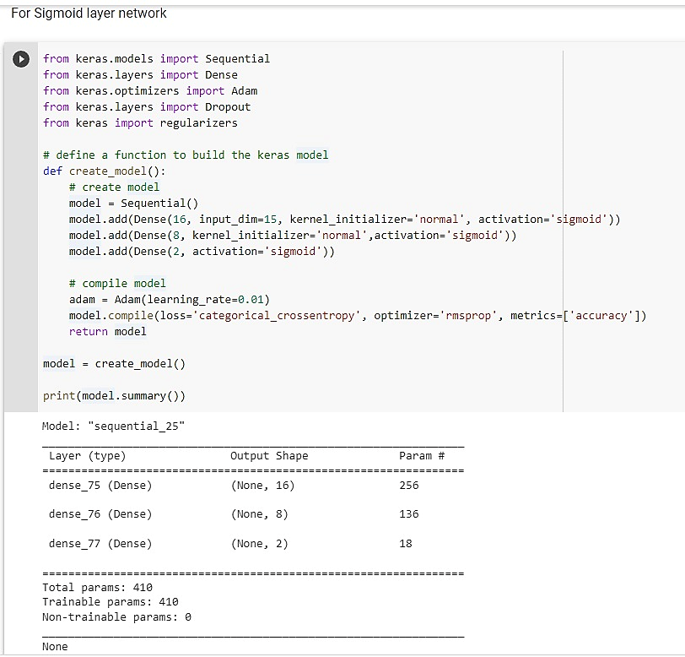
8. Sigmoid layer network:

Slide 17
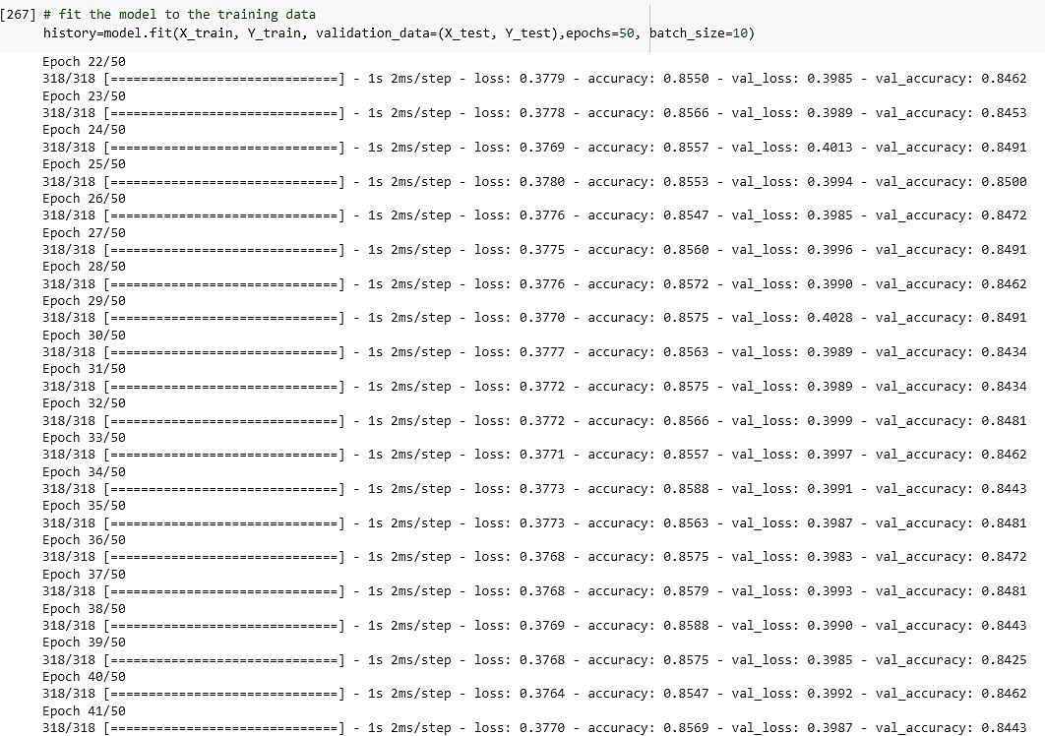
9. Fitting the model to train the sigmoidal datasets:

Slide 18
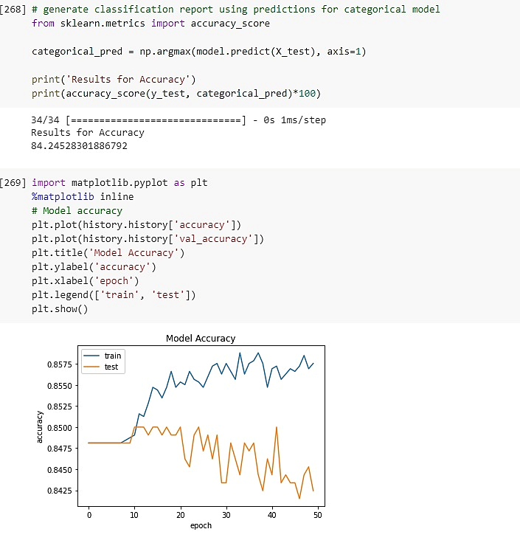
10. Generate classification report using predictions for categorical model for sigmoid:

Slide 19
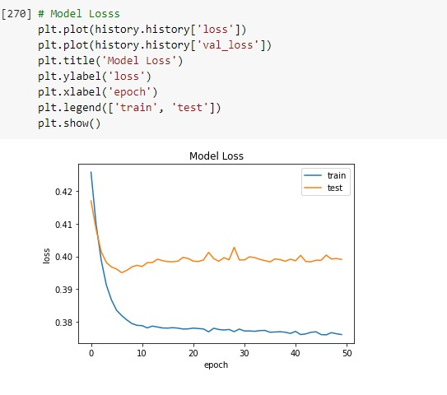
11. Model Losses for sigmoid categorical datasets:

Slide 20
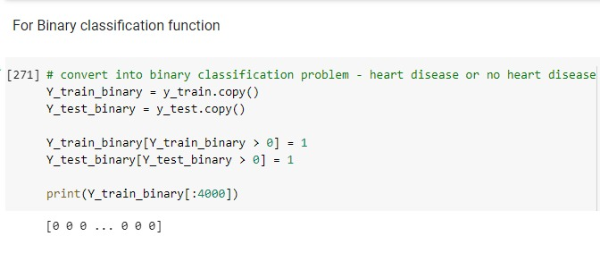
12. Binary Classification Function

Slide 21
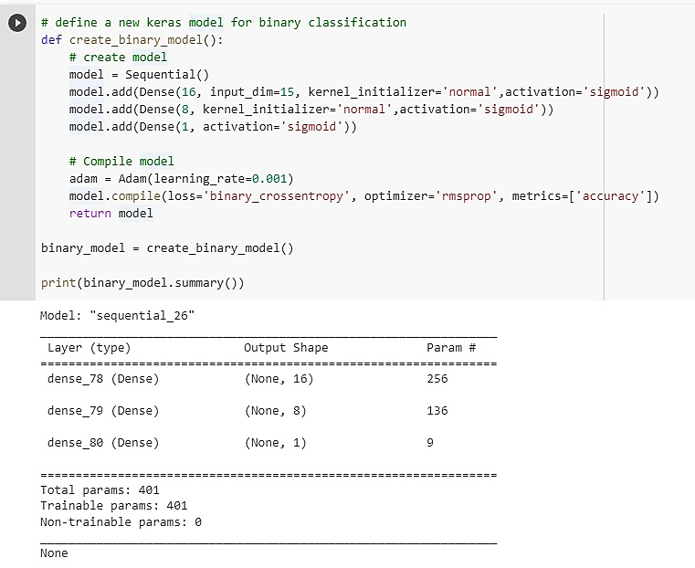
13. Create and compile model for binary classification kernel:

Slide 22
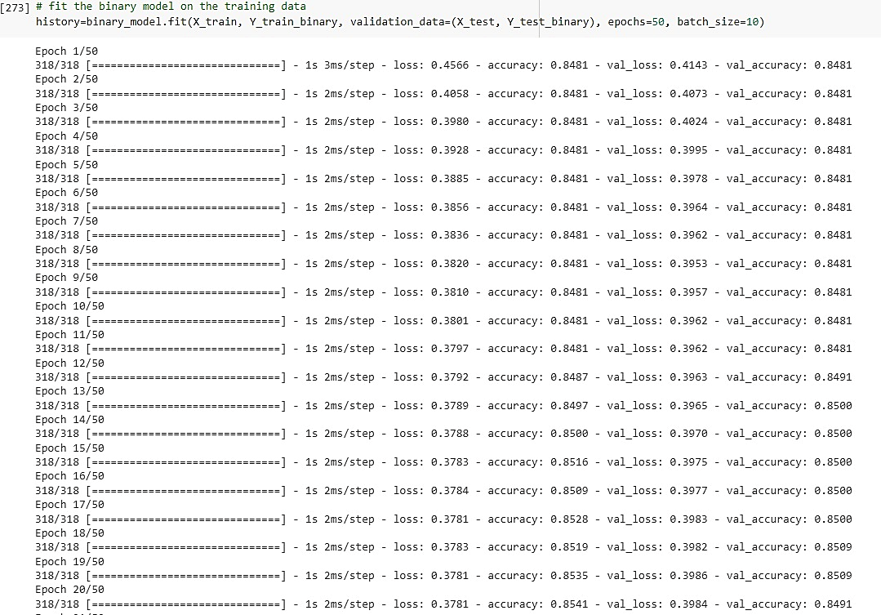
14. Fitting the model to train the binary classification datasets:

Slide 23
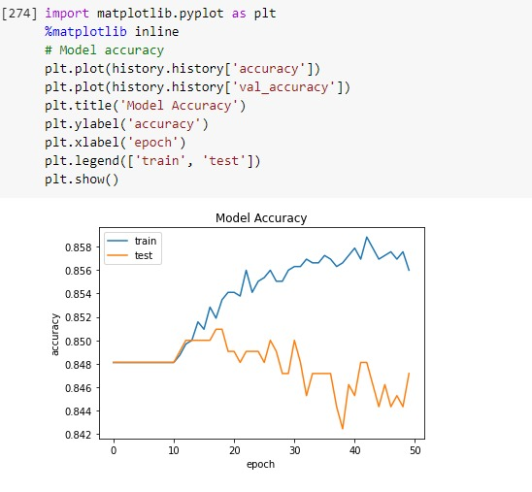
15. Plotting the model accuracy for the binary classification:

Slide 24
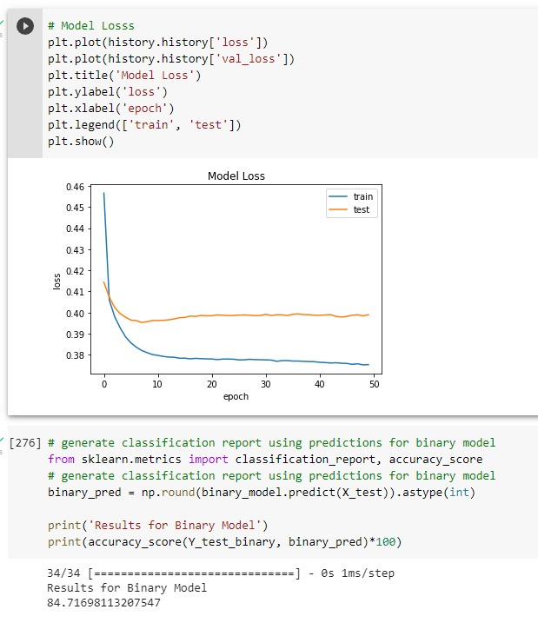
16. Model losses for binary classification and generate report:

Slide 25
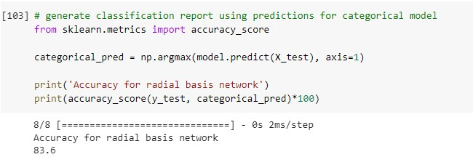
After applying PCA we reduced 15 features into 2 features for Radial Basis Function

Slide 26
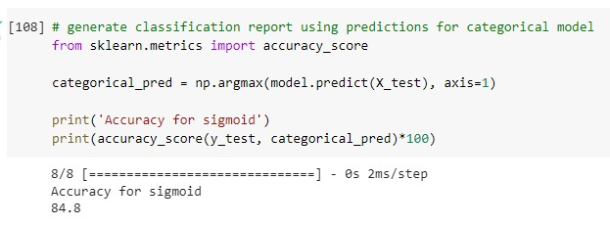
After applying PCA we reduced 15 features into 2 features for Sigmoid function

Slide 27
Neural Network – Inference
Accuracy for Radial Basis Function Network is 70.75% but for PCA accuracy for Radial Basis Function Network is 83.6%, where it is increased.
Accuracy for Sigmoid Activation Network is 84.24% but for PCA accuracy for Sigmoid Activation Network is 84.8%, where it is increased.
Based on the both activation function, sigmoid activation function is good than RBF network, because sigmoid activation network has more accuracy.

Slide 28
Neural Network - Inference
One hot encoding is used to convert integer encoded values in the categorical variable to a new binary value.
On decreasing the batch size, the accuracy rate decreases as lesser number of samples are being processed before the model is updated.
On increasing the number of epochs, the accuracy rate decreases and the loss in values increases. This is due to overfitting of the training data by the model.
There are no non-trainable parameters in the model. This indicates that all the weights are being updated during each epoch in the learning/training process.

Slide 29
Neural Network - Inference
While using sigmoid activation function:
1. In the first few epochs, the accuracy rates do not vary much.
2.For the succeeding epochs, the accuracy rate increases drastically, indicated by a steep increase in the gradient of the accuracy rate plot. Hence using sigmoid activation function will lead to a better learning/training process for the network.
Keras library has been used to implement the neural network model.

Slide 30
Miscellaneous – Neural Network
A neural network is a type of machine learning algorithm modeled after the structure and function of the human brain. It is composed of layers of interconnected "neurons," which process and transmit information.
They can be used for a wide range of tasks, including image and speech recognition, natural language processing, and even playing games.
To train a neural network, you need to feed it a large dataset and adjust the weights and biases of the connections between neurons based on the output it produces.

Slide 31
Miscellaneous – Neural Network
The network adjusts these weights and biases through a process called backpropagation, which helps the network "learn" to produce the desired output for a given input.
Hidden layer: A hidden layer is located between the input and output of the algorithm, in which the function applies weights to the inputs and directs them through an activation function as the output.
Sigmoidal layer: When the activation function for a neuron is a sigmoid function it is a guarantee that the output of this unit will always be between 0 and 1.

Slide 32
Miscellaneous – Neural Network Libraries
from keras.models import Sequential:
A sequential model is appropriate for a plain stack of layers where each layer has exactly one input tensor and one output tensor.
from keras.layers import Dense:
To create a dense layer of function in the model using the keras libraries.
from keras.optimizers import Adam:
Adam optimization is a stochastic gradient descent method that is based on adaptive estimation of first-order and second-order moments.

Slide 33
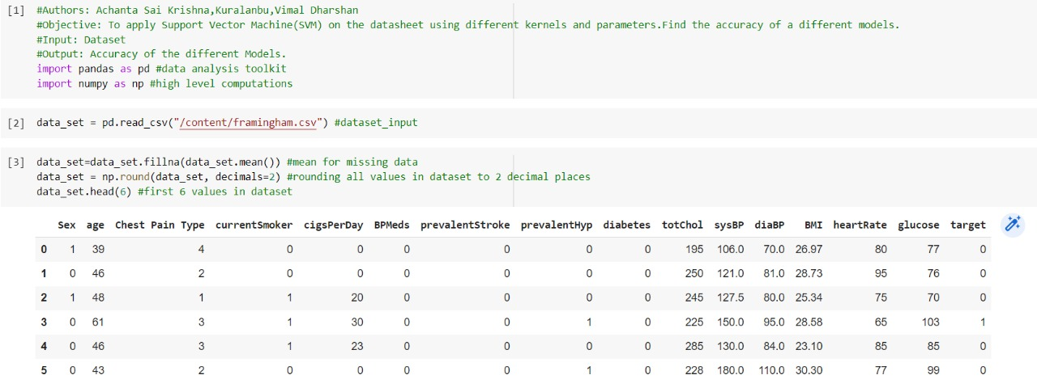
SVM – Supported Vector Machine
1. Importing the Libraries and the Datasets:

Slide 34
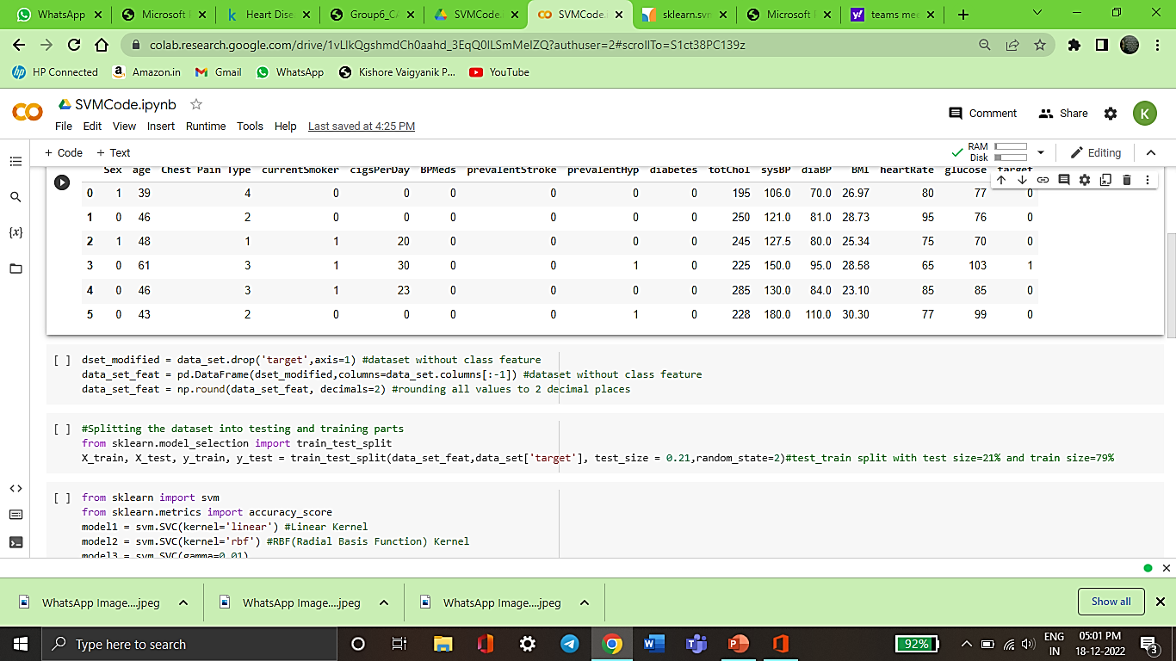
SVM – Supported Vector Machine
2. Splitting the datasets with training and testing of datasets:

Slide 35
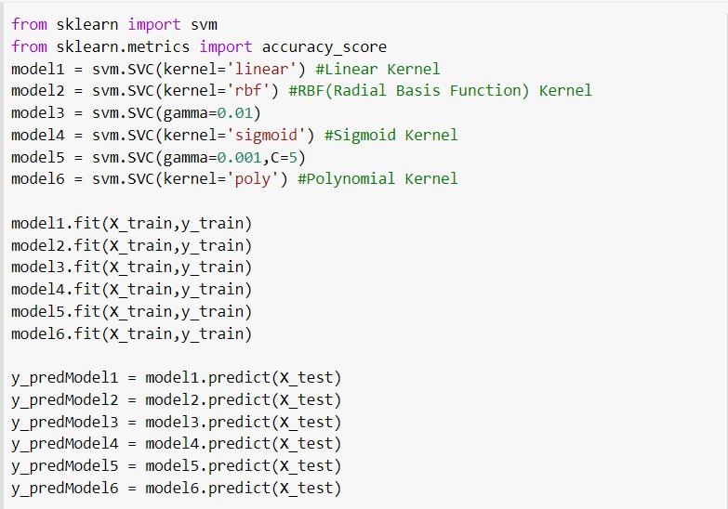
SVM – Supported Vector Machine
3. Importing SVM libraries, and training as well as testing the model:

Slide 36
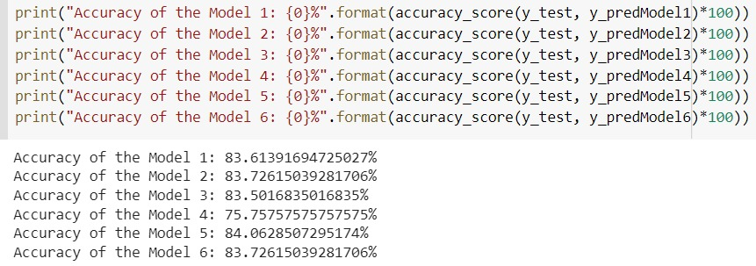
SVM – Supported Vector Machine
4. Printing the accuracies of the model from the training and testing:

Slide 37
SVM Inference
Splitting the datasets into training and testing ,where 79% for training and 21% for testing.
The random state value for training and testing model in SVM is 2.
Comparing all the 6 models accuracies, model 5 has the highest accuracy 84.06%.
Model 4 has the least accuracy 75.75% because we used sigmoid kernel.
For Linear kernel, RBF kernel, Polynomial kernel we got the accuracy value ~83% (approximately).

Slide 38
SVM Inference
We have used six types of model parameters for training and testing of datasets for Support Vector Machines, they’re as follows:
Model 1 depicts the Linear kernel parameter of SVM.
Model 2 depicts the Gaussian Radial Basis Function(RBF) kernel parameter of SVM.
Model 3 depicts the Gamma parameter with scale value of SVM.
Model 4 depicts the Sigmoid kernel parameter of SVM.
Model 5 depicts the Gamma parameter with float value of SVM.
Model 6 depicts the Polynomial kernel parameter of SVM.

Slide 39
Miscellaneous - SVM
In machine learning, support vector machines (SVMs, also support vector networks) are supervised learning models with associated learning algorithms that analyze data for classification and regression analysis.
Basically, SVM finds a hyper-plane that creates a boundary between the types of data. In 2-dimensional space, this hyper-plane is nothing but a line.
In SVM, we plot each data item in the dataset in an N-dimensional space, where N is the number of features/attributes in the data. Next, find the optimal hyperplane to separate the data.

Slide 40
Miscellaneous – SVM
Important Parameters of Kernelized SVM:
The Kernel: The kernel, is selected based on the type of data and also the type of transformation. By default, the kernel is Radial Basis Function Kernel (RBF).
Gamma : This parameter decides how far the influence of a single training example reaches during transformation, which in turn affects how tightly the decision boundaries end up surrounding points in the input space. If there is a small value of gamma, points farther apart are considered similar. So more points are grouped together and have smoother decision boundaries (maybe less accurate). Larger values of gamma cause points to be closer together (may cause overfitting).
The ‘C’ parameter: This parameter controls the amount of regularization applied to the data. Large values of C mean low regularization which in turn causes the training data to fit very well (may cause overfitting). Lower values of C mean higher regularization which causes the model to be more tolerant of errors (may lead to lower accuracy).

Slide 41
Miscellaneous - SVM
Linear Kernel: It is used when the data is Linearly separable, that is, it can be separated using a single Line.
Gaussian Radial Basis Kernel: the kernel function that is used in machine learning to find a non-linear classifier or regression line. It is a function whose value depends on the distance from the origin or from some point.
Sigmoid Kernel: When the activation function for a neuron is a sigmoid function it is a guarantee that the output of this unit will always be between 0 and 1.
Polynomial Kernel: It represents the similarity of vectors (training samples) in a feature space over polynomials of the original variables, allowing learning of non-linear models.

Slide 42
Miscellaneous – SVM
Training data is the initial dataset used to train machine learning algorithms. Models create and refine their rules using this data.
Testing datasets are small contrived problems that allow you to test and debug your algorithms and test harness. They are also useful for better understanding the behavior of algorithms in response to changes in hyperparameters.
The Random State hyperparameter in the train_test_split() function controls the shuffling process. If the random state value is changed then the value of training and testing differs.

Slide 43
Miscellaneous – SVM Libraries
from sklearn.model_selection import train_test_split:
Split arrays or matrices into random train and test subsets. Quick utility that wraps input validation, next(ShuffleSplit().split(X, y)), and application to input data into a single call for splitting data into a one-linear.
from sklearn.metrics import accuracy_score:
Accuracy classification score. In multilabel classification, this function computes subset accuracy: the set of labels predicted for a sample must exactly match the corresponding set of labels in y_true.

Slide 44
Miscellaneous – SVM Libraries
from sklearn import svm
class sklearn.svm.SVC:
svm.SVC(kernel='linear’/’rbf’/’sigmoid’/’poly’):
Specifies the kernel type to be used in the algorithm. If none is given, ‘rbf’ will be used. If a callable is given it is used to pre-compute the kernel matrix from data matrices; that matrix should be an array of shape (n_samples, n_samples).
svm.SVC(gamma=‘scale’/’auto’/’float’):
if gamma=‘scale’ is passed then it uses 1/(n_features.X.var()) as value of gamma,
if ‘auto’, uses 1/n_features.
if float, must be non-negative.

